Slide 1
Chapter 9
Strings

Slide 2
想一想
Char只能顯示ASCII字元，想輸出非ASCII字元(如全形字、符號，該怎麼做？)
在一般輸入時的整行輸入如果需要應對不同格式，要怎麼做讀取以及操作？

Slide 3
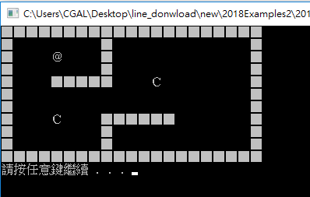
想一想
Char只能顯示ASCII字元，想輸出非ASCII字元(如全形字、符號，該怎麼做？)
可以使用字串形式做輸出！
在一般輸入時的整行輸入如果需要應對不同格式，要怎麼做讀取以及操作？
String內含方便操作的函式：包含讀整行的getline()及取得長度的.length()等，可以再行操作！

Slide 4
Learning Objectives
An Array Type for Strings
C-Strings
Character Manipulation Tools
Character I/O
get, put member functions
putback, peek, ignore
Standard Class string
String processing

Slide 5
Introduction
Two string types:
C-strings → char cstring[256] = “Start Game!”;
Array with base type char and can be indexed as an array.
End of string marked with null, ‘\0’, and hold Length – 1 characters.
Be careful not to overwrite the ‘\0’ character.
"Older" method inherited from C.
Typically "partially-filled" array: large enough to hold max-size string and end with null
String class → string sstring = “Start Game!”;
Uses templates
s[0] s[1] s[2] s[3] s[4] s[5] s[6] s[7] s[8] s[9] s[10] s[11] s[12] s[13]
S | t | a | r | t |  | G | a | m | e | ! | \0 | ? | ?

Slide 6
C-Strings
Array with base type char
One character per indexed variable
One extra character: "\0"
Called "null character"
End marker
We’ve used c-strings
Literal "Hello" stored as c-string

Slide 7
C-String Variable
Array of characters: char s[10];
Declares a c-string variable to hold up to 9 characters
+ one null character
Typically "partially-filled" array
Declare large enough to hold max-size string
Indicate end with null
Only difference from standard array:
Must contain null character

Slide 8
C-String Storage
A standard array: char s[10];
If s contains string "Hi Mom", stored as:

Slide 9
C-String Initialization
Can initialize c-string: char startMessage[20] = “Start Game!”
Needn’t fill entire array
Initialization places "\0" at end
Can omit array-size: char firstWord[] = “Start";
Automatically makes size one more than length of quoted string
NOT same as:
char firstWord[] = {‘S’, ‘t’, ‘a’, ‘r’, ‘t’};
It is the same as
char firstWord[] = {‘S’, ‘t’, ‘a’, ‘r’, ‘t’, ‘\0’};
What about?
char firstWord[] = {“S”, “t”, “a”, “r”, “t”, “\0”};

Slide 10
C-String Indexes
A c-string IS an array
Can access indexed variables of: char ourString[5] = "Hi";
ourString[0] is "H"
ourString[1] is "i"
ourString[2] is "\0"
ourString[3] is unknown
ourString[4] is unknown

Slide 11
C-String Index Manipulation
Can manipulate indexed variables char happyString[7] = "DoBeDo"; happyString[6] = "Z";
Be careful!
Here, "\0" (null) was overwritten by a "Z"!
If null overwritten, c-string no longer "acts" like c-string!
Unpredictable results!

Slide 12
Library
Declaring c-strings
Requires no C++ library
Built into standard C++
Manipulations
Require library <cstring>
Typically included when using c-strings
Normally want to do "fun" things with them

Slide 13
= and == with C-strings
C-strings not like other variables
Cannot assign or compare: char aString[10];
char bString[10] = “End Game"; aString = “Start Game"; // ILLEGAL!
aString == bString; // NOT allowed!
Can ONLY use "=" at declaration of c-string!
Must use library function for assignment and comparison: strcpy(aString, “Start!");
if (strcmp(aString, bString)) cout << "Strings NOT same."; else cout << "Strings are the same.";
Built-in function (in <cstring>)
Sets value of aString equal to “Start"
NO checks for size!
Up to programmer, just like other arrays!

Slide 14
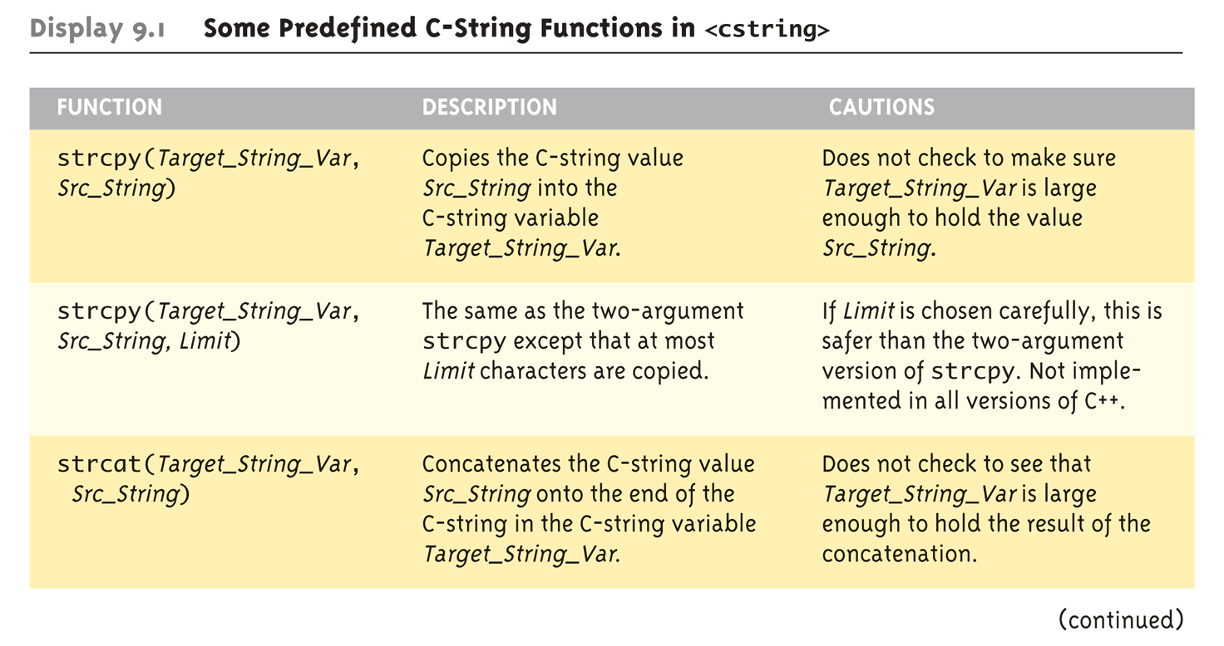
The <cstring> Library: Display 9.1 Some Predefined C-String Functions in <cstring> (1 of 2)
Full of string manipulation functions

Slide 15
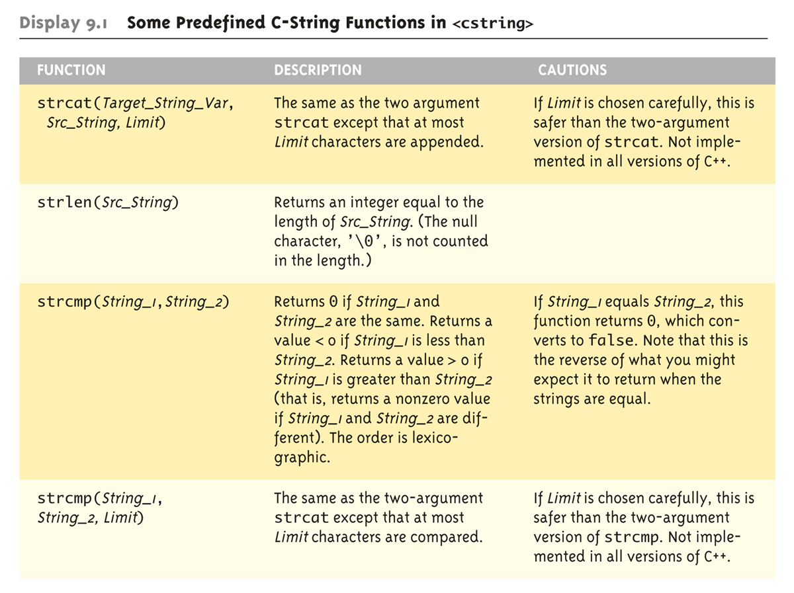
The <cstring> Library: Display 9.1 Some Predefined C-String Functions in <cstring> (2 of 2)

Slide 16
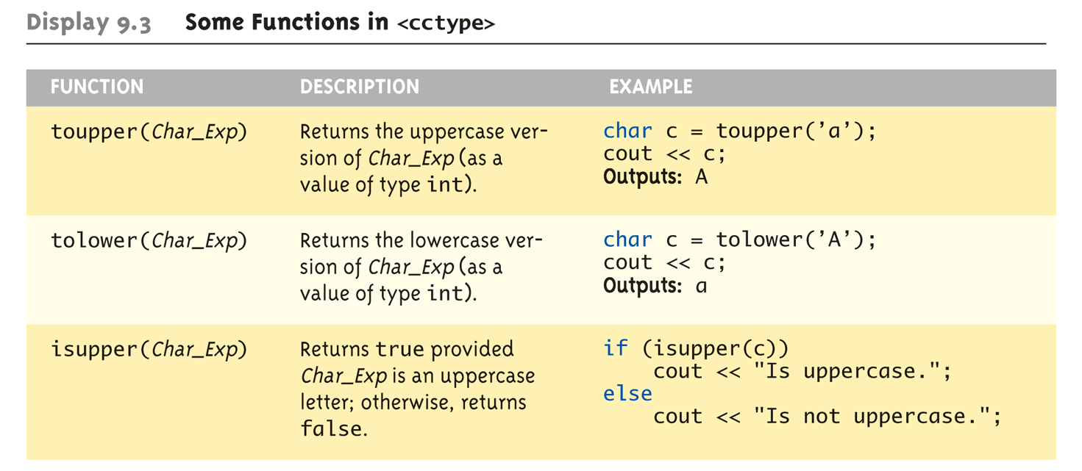
Character-Manipulating Functions: Display 9.3 Some Functions in <cctype> (1 of 3)

Slide 17
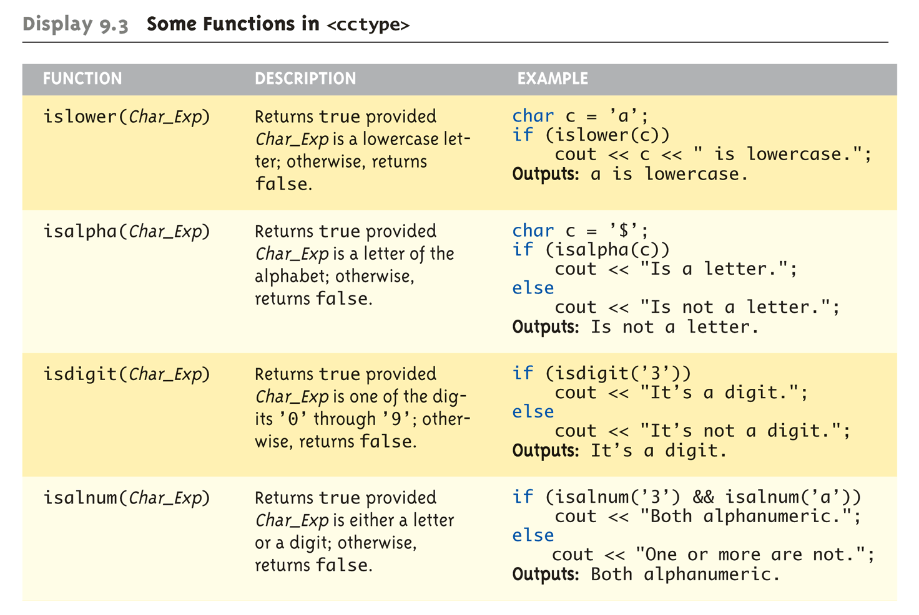
Character-Manipulating Functions: Display 9.3 Some Functions in <cctype> (3 of 3)

Slide 18
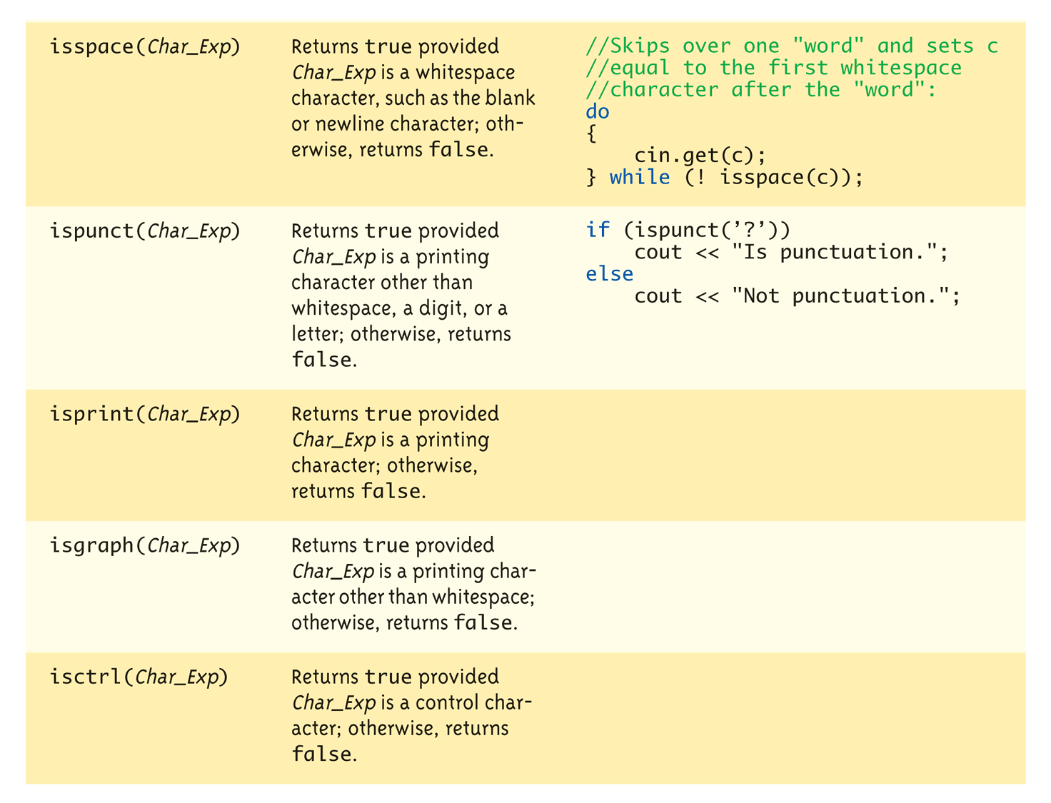
Character-Manipulating Functions: Display 9.3 Some Functions in <cctype> (3 of 3)

Slide 19
C-string Functions: strlen()and strcat()
"String length"
Often useful to know string length: char startString[10] = “Start!"; cout << strlen(startString);
Returns number of characters but Not including null
Result here: 6
"String concatenate": char exampleString[20] = “Game"; strcat(exampleString, “Start!");
Note result: stringVar now contains “GameStart!"
Be careful! Generally, you should incorporate spaces. ‘ ‘, as needed!

Slide 20
C-string Arguments and Parameters
Recall: c-string is array
So c-string parameter is array parameter
C-strings passed to functions can be changed by receiving function!
Like all arrays, typical to send size as well
Function "could" also use ‘\0’ to find end
So size not necessary if function won’t change c-string parameter
Use "const" modifier to protect c-string arguments

Slide 21
C-String Output
Can output with insertion operator, <<
As we’ve been doing already: cout << count << " Round.\n"; //count is c-string
Possible because << operator is overloaded for c-strings!

Slide 22
C-String Input
Can input with extraction operator, >>
Issues exist, however
Whitespace is "delimiter"
Tab, space, line breaks are "skipped"
Input reading "stops" at delimiter
Watch size of c-string
Must be large enough to hold entered string!
C++ gives no warnings of such issues!

Slide 23
C-String Input Example
char a[80], b[80]; cout << "Enter input: "; cin >> a >> b; cout << a << b << "END OF OUTPUT\n";
Dialogue offered: Enter input: Do be do to you! DobeEND OF OUTPUT
Note: Underlined portion typed at keyboard
C-string a receives: "do"
C-string b receives: "be"

Slide 24
C-String Line Input
Can receive entire line into c-string
Use getline(), a predefined member function: char a[80]; cout << "Enter input: "; cin.getline(a, 80); cout << a << "END OF OUTPUT\n";
Dialogue: Enter input: Start Game in 5! Start Game in 5!END OF INPUT
Can explicitly tell length to receive: char shortString[5]; cout << "Enter input: "; cin.getline(shortString, 5); cout << shortString << "END OF OUTPUT\n";
Results: Enter input: Start Game in 5! StarEND OF OUTPUT
Only FOUR characters be read
Recall need for null character!

Slide 25
Command Line Arguments
Programs invoked from the command line (e.g. a UNIX shell, DOS command prompt) can be sent arguments
Example: COPY C:\FOO.TXT D:\FOO2.TXT
This runs the program named “COPY” and sends in two C-String parameters, “C:\FOO.TXT” and “D:\FOO2.TXT”
It is up to the COPY program to process the inputs presented to it; i.e. actually copy the files
Header for main: int main(int argc, char *argv[])
argc specifies how many arguments are supplied. The name of the program counts, so argc will be at least 1.
argv is an array of C-Strings.
argv[0] holds the name of the program that is invoked
argv[1] holds the name of the first parameter
argv[2] holds the name of the second parameter
Etc.

Slide 26
Example: Command Line Arguments
// Echo back the input arguments
int main(int argc, char *argv[])
{
for (int i=0; i<argc; i++)
{
cout << "Argument " << i << " " << argv[i] << endl;
}
return 0;
}
Sample Execution
> Test hello world
Argument 0 Test
Argument 1 hello
Argument 2 world
Sample Execution
> Test
Argument 0 Test
Invoking Test
from command
prompt

Slide 27
Character I/O
Input and output data
ALL treated as character data e.g., number 10 outputted as "1" and "0"
Conversion done automatically by using low-level utilities
Can use the same low-level utilities ourselves as well

Slide 28
cin.get() and cout.put()
cin.get(): reads one char at a time
char nextMoveDirection; cin.get(nextMoveDirection);
Reads next char & puts in variable nextMoveDirection
Argument must be char type
Not "string"!
cout.put(): Outputs one character at a time
cout.put(‘a’); // Outputs “a” to screen
char myString[10] = “Game Start”;
cout.put(myString[1]); // Outputs “a” to screen

Slide 29
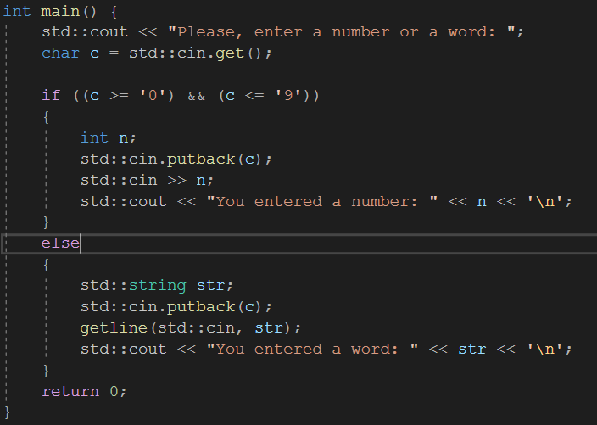
More Member Functions
putback()
Once read, might need to "put back"
cin.putback(lastChar);
peek()
Returns next char, but leaves it there
peekChar = cin.peek();
ignore()
Skip input, up to designated character
cin.ignore(1000, ‘\n’);
Skips at most 1000 characters until "\n"

Slide 30
Standard Class string
Defined in library: #include <string>
String variables and expressions: much like simple types
Can assign, compare, add: std::string s1, s2, s3; s3 = s1 + s2; //Concatenation s3 = “Game Start!” //Assignment
Note c-string “Game Start!" automatically converted to string type!

Slide 31
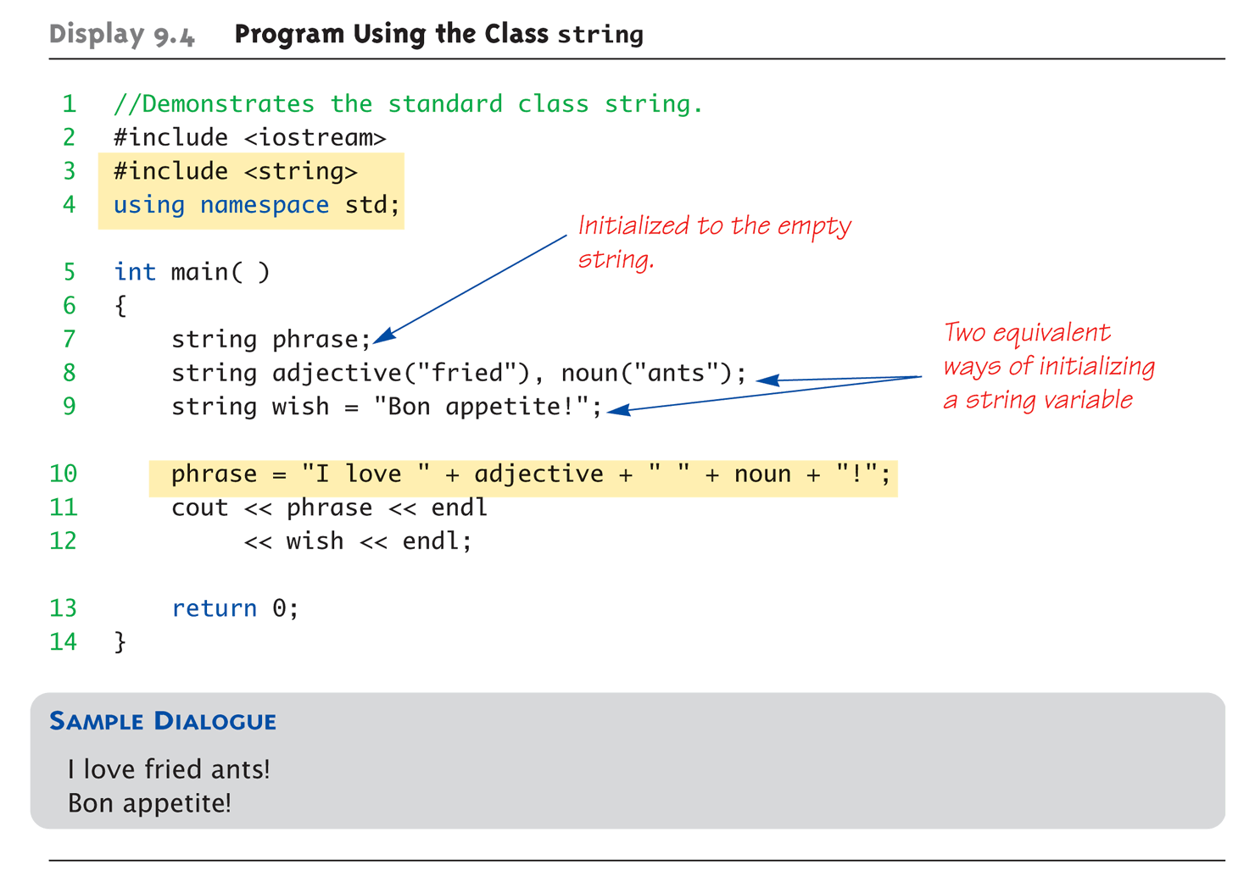
Display 9.4: Program Using the Class string

Slide 32
String Class: Member Functions
Member functions
(constructor) // constructs a basic_string
operator= // assigns values to the string
…
Member functions- Element Access
at //access specified character with bounds checking
operator[] // access specified character
Front // accesses the first character
….
Find()
Non-member functions
operator +
…
stoi …
http://en.cppreference.com/w/cpp/string/basic_string

Slide 33
find()
int main() {
std::string::size_type n;
std::string const s = "This is a string";
// search from beginning of string
n = s.find("is"); print(n, s);
// search from position 5
n = s.find("is", 5); print(n, s);
// find a single character
n = s.find('q');
print(n, s);
}
#include <string>
#include <iostream>
void print(std::string::size_type n, std::string const &s) {
if (n == std::string::npos) {
std::cout << "not found\n";
} else {
std::cout << "found: " << s.substr(n) << '\n';
}
}

Slide 34
find()
#include <string>
#include <iostream>
void print(std::string::size_type n, std::string const &s)
{
if (n == std::string::npos) {
std::cout << "not found\n";
} else {
std::cout << "found: " << s.substr(n) << '\n';
}
}

Slide 35
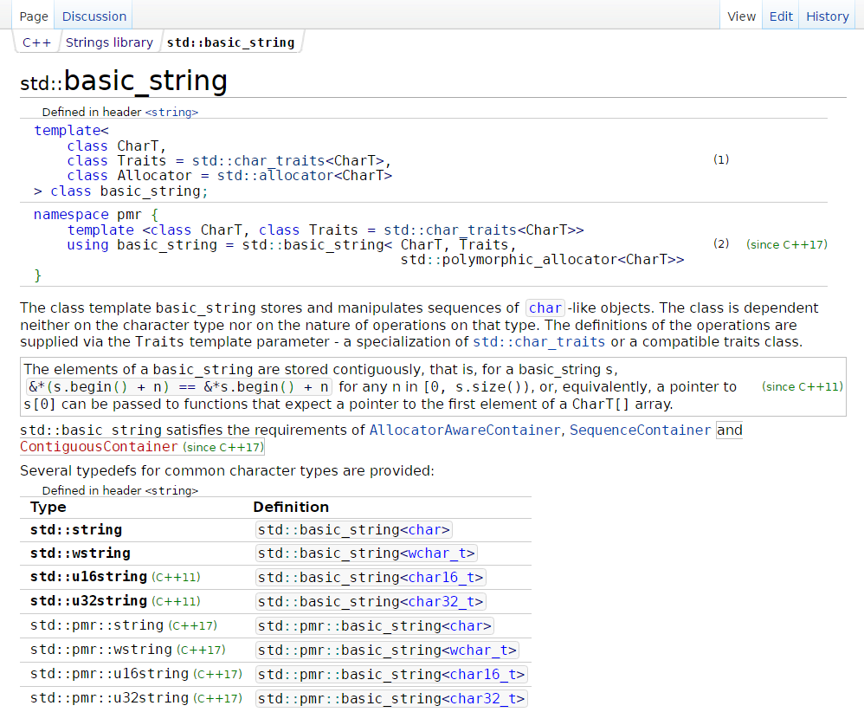
String Class
http://en.cppreference.com/w/cpp/string/basic_string

Slide 36
I/O with Class string
Just like other types!
string s1, s2; cin >> s1; cin >> s2;
Results: User types in: Move one step to the right!
Extraction still ignores whitespace: s1 receives value "Move" s2 receives value “one"

Slide 37
getline() with Class string
For complete lines: string line; cout << "Enter a line of input: "; getline(cin, line); cout << line << "END OF OUTPUT";
Dialogue produced: Enter a line of input: Do be do to you! Do be do to you!END OF INPUT
Similar to c-string’s usage of getline()

Slide 38
Other getline() Versions
Can specify "delimiter" character: string line; cout << "Enter input: "; getline(cin, line, "?");
Receives input until "?" encountered
getline() actually returns reference
string s1, s2; getline(cin, s1) >> s2;
Results in: (cin) >> s2;

Slide 39
Pitfall: Mixing Input Methods
Be careful mixing cin >> var and getline
int n; string line; cin >> n; getline(cin, line);
If input is: 42 Game Start!
Variable n set to 42
line set to empty string!
cin >> n skipped leading whitespace, leaving "\n" on stream for getline()!

Slide 40
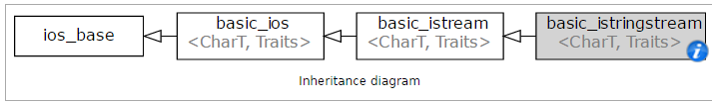
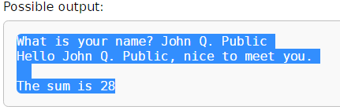
getline() Example
int main()
{
// greet the user
std::string name;
std::cout << "What is your name? ";
std::getline(std::cin, name);
std::cout << "Hello " << name << ", nice to meet you.\n";
// read file line by line
std::istringstream input;
input.str("1\n2\n3\n4\n5\n6\n7\n");
int sum = 0;
for (std::string line; std::getline(input, line); ) {
sum += std::stoi(line);
}
std::cout << "\nThe sum is: " << sum << "\n";
}
http://en.cppreference.com/w/cpp/io/basic_istringstream

Slide 41
Class string Processing
Same operations available as c-strings
And more!
Over 100 members of standard string class
Some member functions:
.length()
Returns length of string variable
.at(i)
Returns reference to char at position i

Slide 42
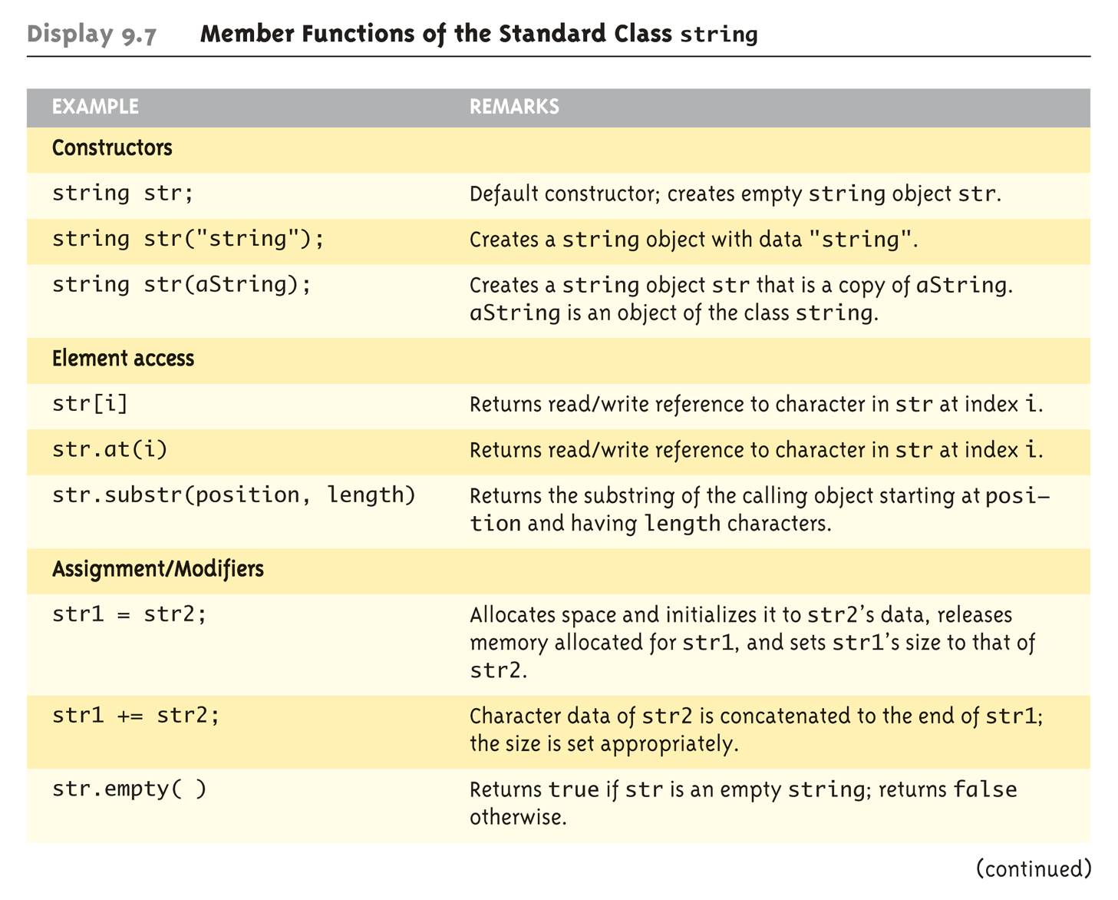
Display 9.7 Member Functions of the Standard Class string (1 of 2)

Slide 43
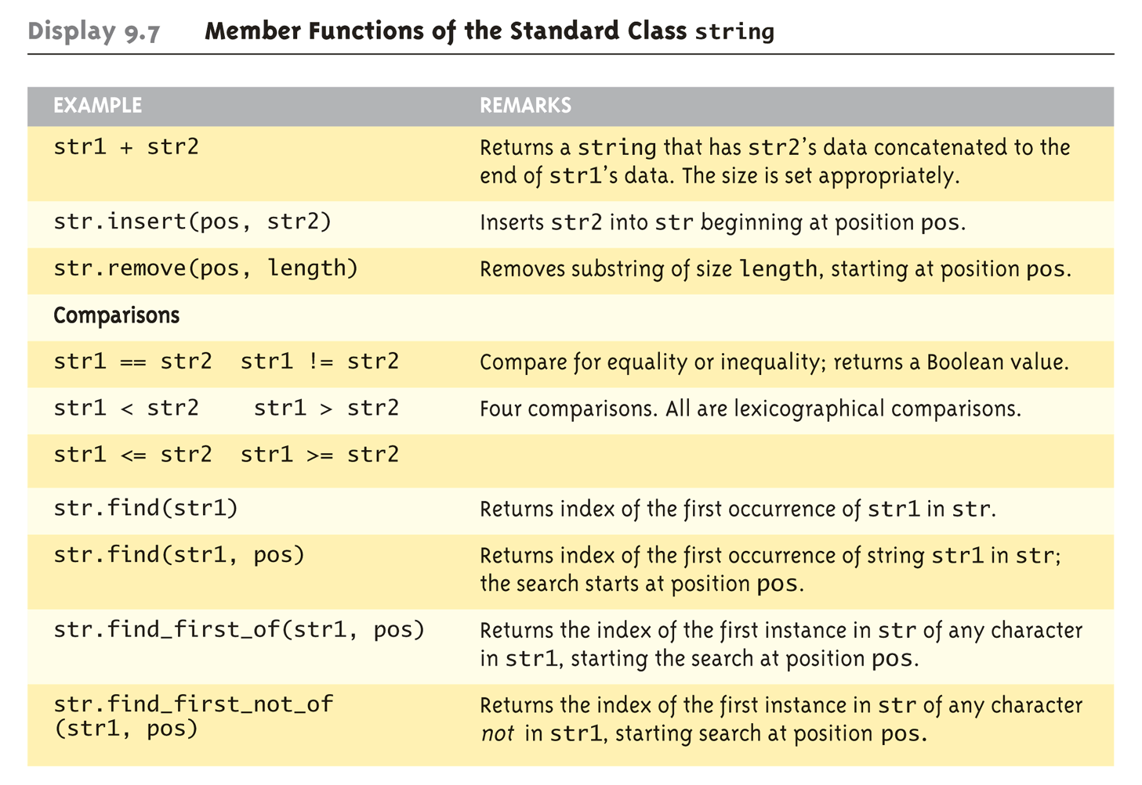
Display 9.7 Member Functions of the Standard Class string (2 of 2)

Slide 44
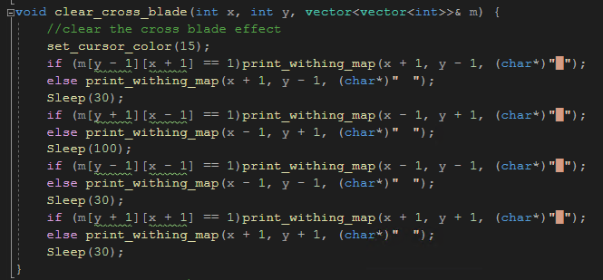
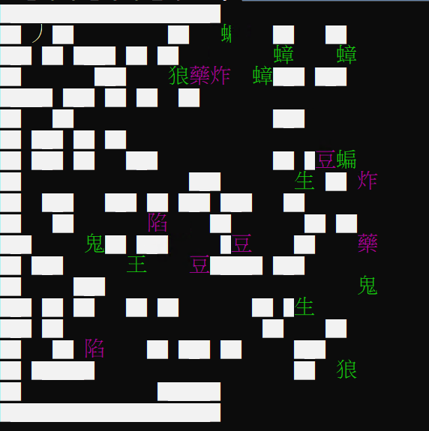
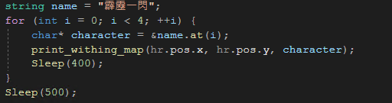
Difference between reading string and char
Char confines input to ASCII characters, special characters unable to use.
String inputs enable other possibilities:

Slide 45
Encoding & Codepage
IBM 時即以 codepage 稱呼 BIOS 支援的字元編碼
ASCII 是英語區的 codepage
使用 7bit 表示一個英數字及符號
資策會聯合倚天中文等台灣軟體商定義 big5 編碼以表示繁體中文，使用 2 byte 表示一個漢字。
BBS 雙色字就是針對這兩個 byte 上不同顏色產生的 bug/feature
微軟推出繁中版 windows 時，採用 big5 編碼， codepage 編號 950
萬國碼推出可變長度編碼的 utf8 統一全世界所有語言的編碼，在 windwos 中 codepage 編號 65001

Slide 46
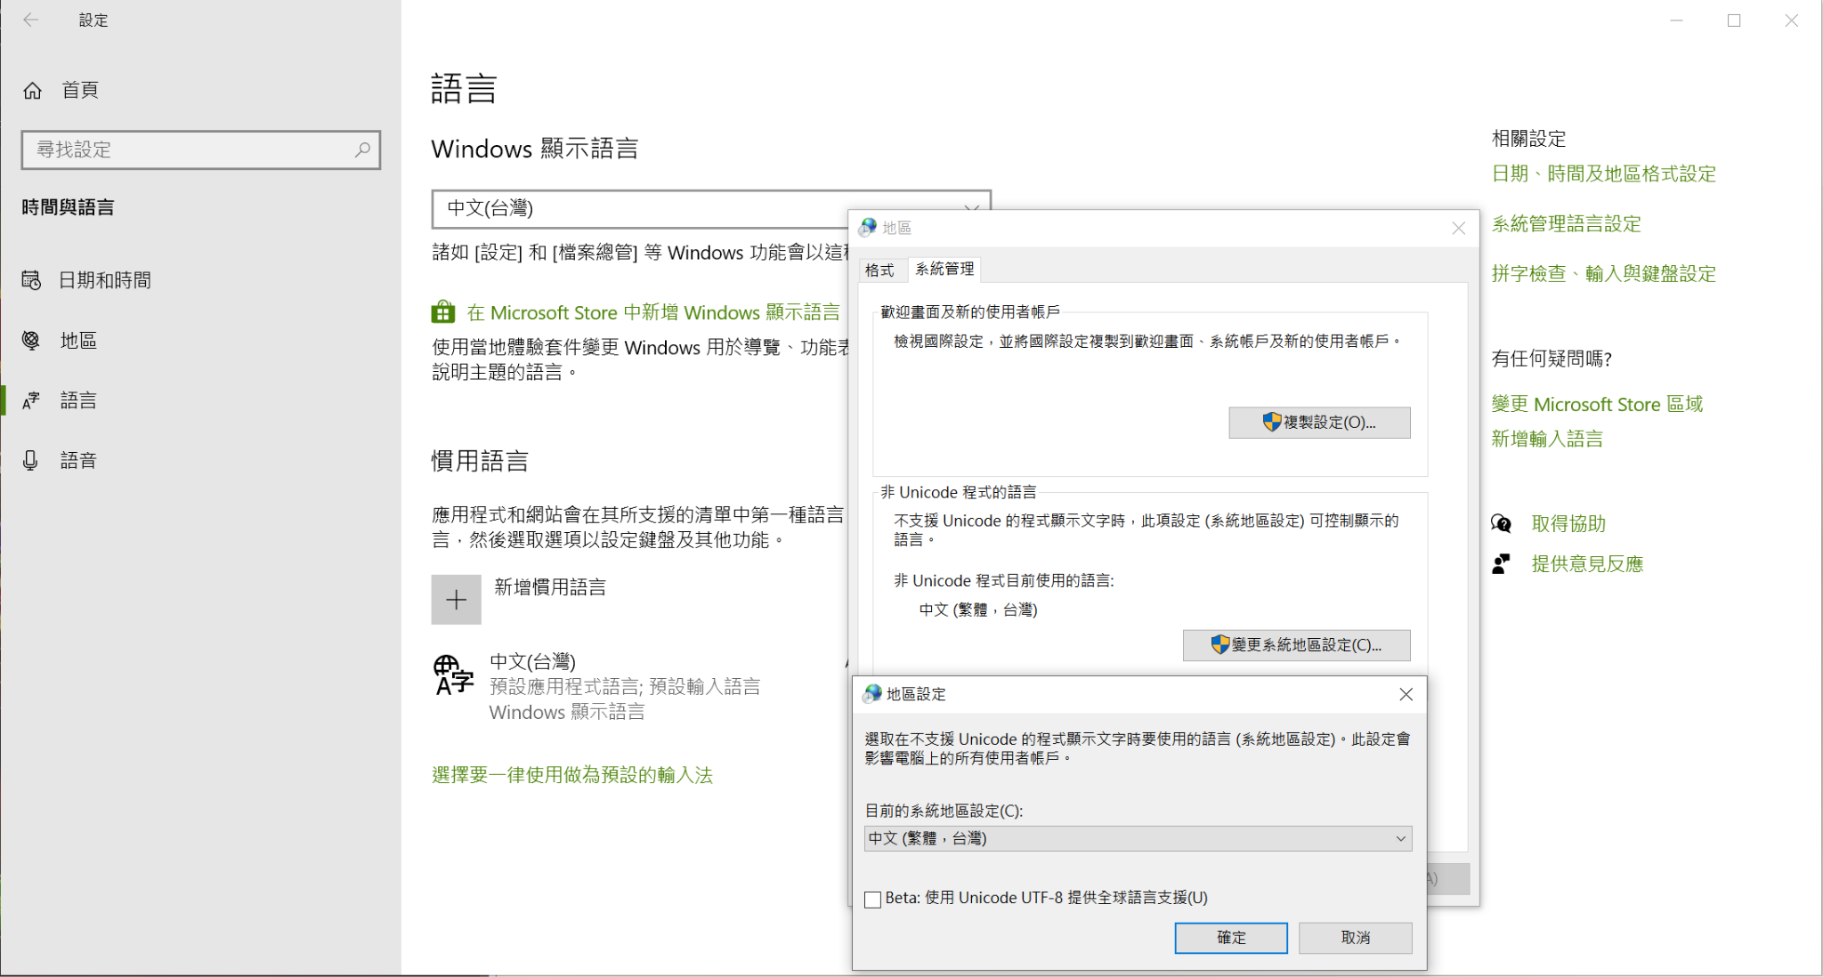
Encoding & Codepage

Slide 47
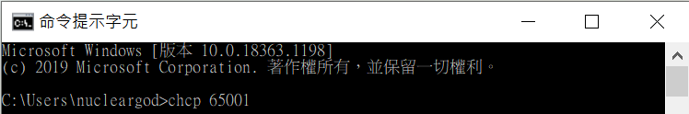
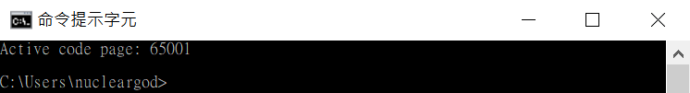
Encoding & Codepage
Linux 除非特別設定，全部都是 utf8 編碼
Windows 命令列預設編碼是控制台上選的
可以用 chcp 指令切換 codepage

Slide 48
Encoding & Codepage
直接寫在原始碼中的字串，內容受原始碼檔案使用的文字編碼影響
big5.cpp：std::cout << “測試\n”;
編譯
在 utf8 環境執行
輸出亂碼！

Slide 49
Encoding & Codepage
C++ 可以指定字面字串為 utf8 編碼
system(“chcp 65001”);
std::string str = u8”測試”;
std::cout << str << “\n”;
其他各國編碼：建議使用 libicu
https://github.com/unicode-org/icu
注意原始碼檔案的編碼以及編譯器的編碼選項

Slide 50
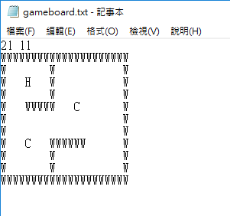
Example: Load & Translate Board Data
地城遊戲中需要有存讀檔功能讓玩家可保留遊玩進度
檔案中有地圖版面資訊、玩家與生物位置
使用getline 處理讀取的資訊
文件中儲存有版面(大小、牆壁分布)、玩家與生物的資訊
利用讀檔ifstream與string 功能將資訊讀進遊戲中

Slide 51
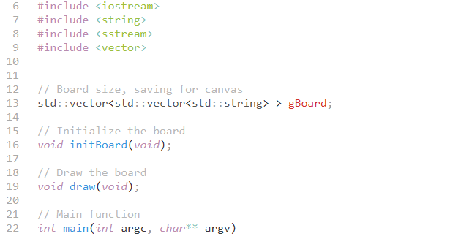
Example: Load & Translate Board Data
include lib
版面資料變數
版面初始化與讀取檔案
輸出版面

Slide 52
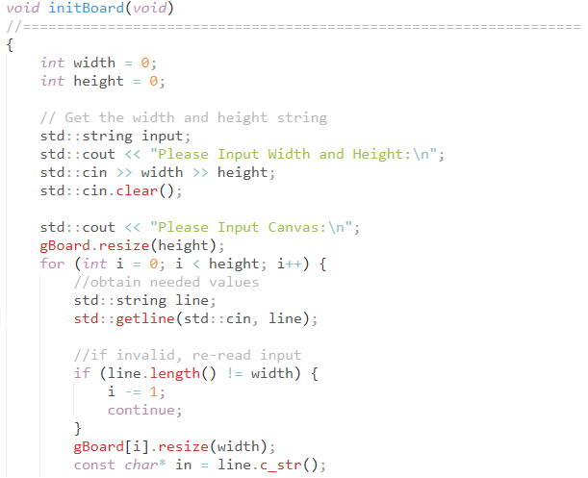
Example: Load & Translate Board Data
讀取版面大小
讀取地圖資料

Slide 53
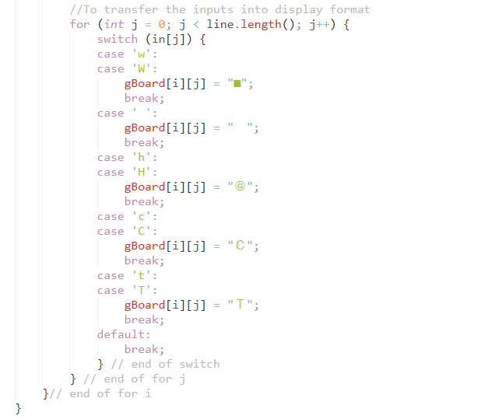
Example: Load & Translate Board Data
根據檔案文字轉為版面合法資料

Slide 54
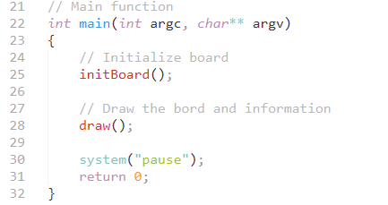
Example: Load & Translate Board Data
讀取輸入
輸出版面

Slide 55
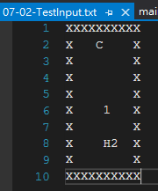
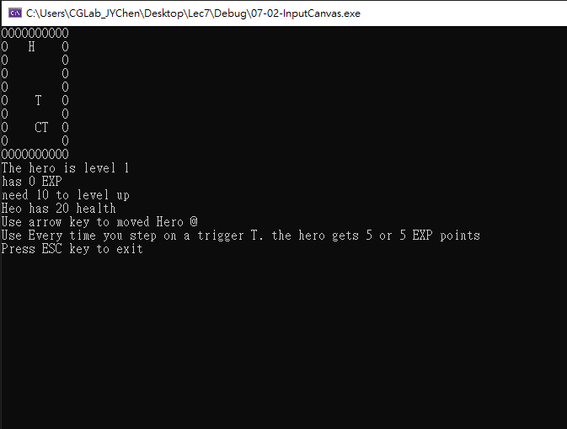
Example: Input Canvas & Elements
Playable State
Line Inputs

Slide 56
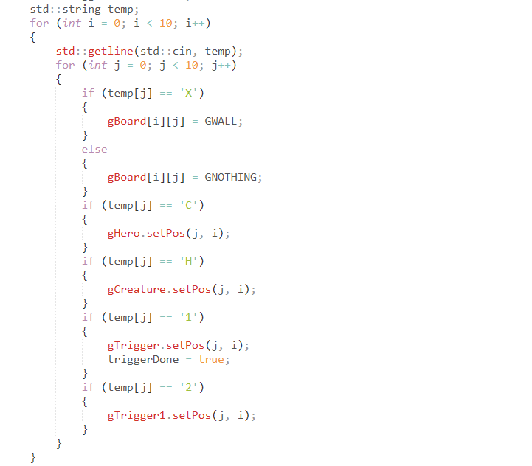
Example: Input Canvas & Elements
讀取輸入
建立合法位置
遊戲內移至對應位置
更改物件參數

Slide 57
C-string and string Object Conversions
Automatic type conversions
From c-string to string object: char aCString[] = “Game Start!"; string stringVar; stringVar = aCstring; // Legal and appropriate!
From string to c-string must use explicit conversion:
strcpy(aCString, stringVar.c_str());
aCString = stringVar; //ILLEGAL! No auto-conversion

Slide 58
Summary
C-string variable is "array of characters"
With addition of null character, "\0"
C-strings act like arrays
Cannot assign, compare like simple variables
Libraries <cctype> & <string> have useful manipulating functions
cin.get() reads next single character
getline() versions allow full line reading
Class string objects are better-behaved than c-strings

Slide 59
Class Design Workshop

Slide 60
5 Cards Poker Game (5PK)
In a typical 5 cards poker game, each player gets a hand of 5 cards.
The deck(一副牌) is shuffled and cards are dealt one at a time from the deck and added to the players' hands.
In some games, cards can be removed from a hand, and new cards can be added.
The game is won or lost depending on
the value (ace, 2, ..., king) and
suit (spades, diamonds, clubs, hearts)
of the cards that a player receives.
The ranking list as for hands is shown
See next page

Slide 61
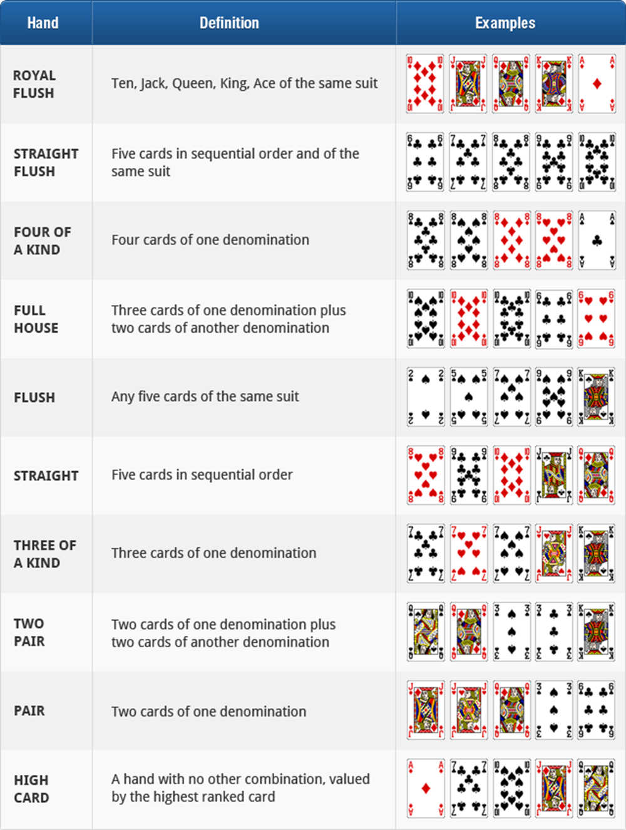
5 card poker hands ranking:

Slide 62
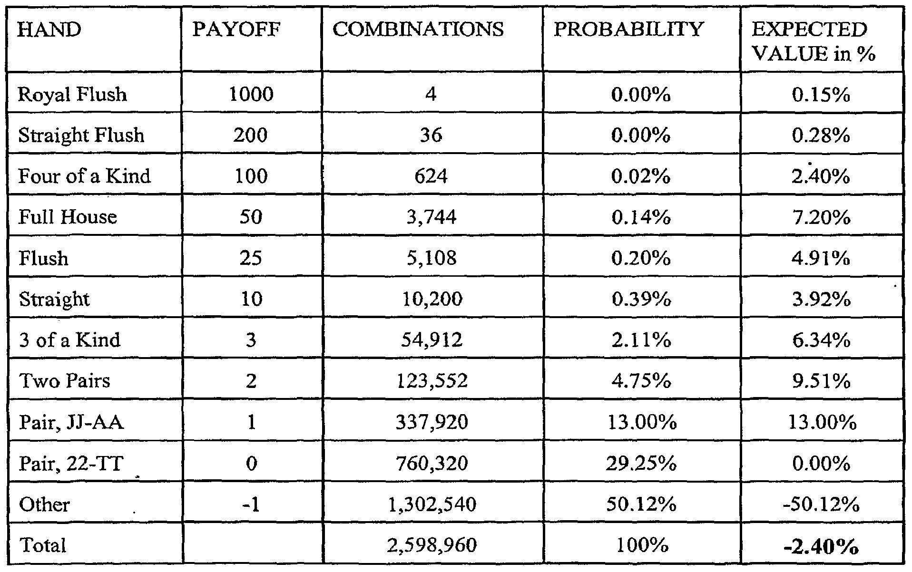
Write a program of 5PK for one player who plays with computer

Slide 63
5PK type I: Five-card Stud
Players and Cards
52-card deck is used, and only five cards per player are dealt.
The Play
The deck is shuffled.
The player places an ante (bet) in the pot.
The player is dealt 5 cards (hand) face up, one at a time from the deck and added to the players' hands.
The player wins if his/her hand is on the hands ranking list.
Note that the banker is your program (computer)
Repeat to step 1.

Slide 64
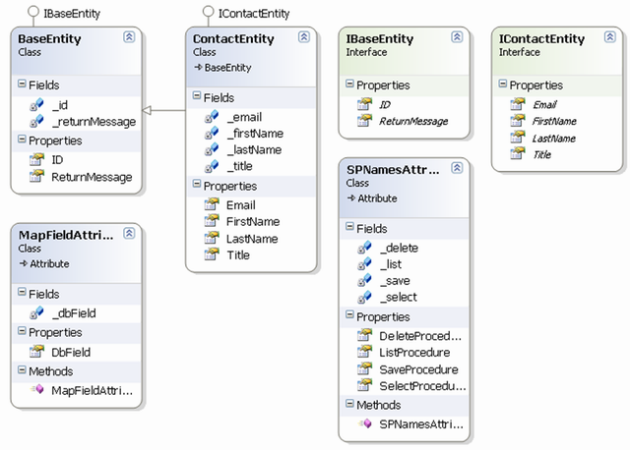
Let’s start to design “Classes”
Tell me your Classes for this game

